Slide 1
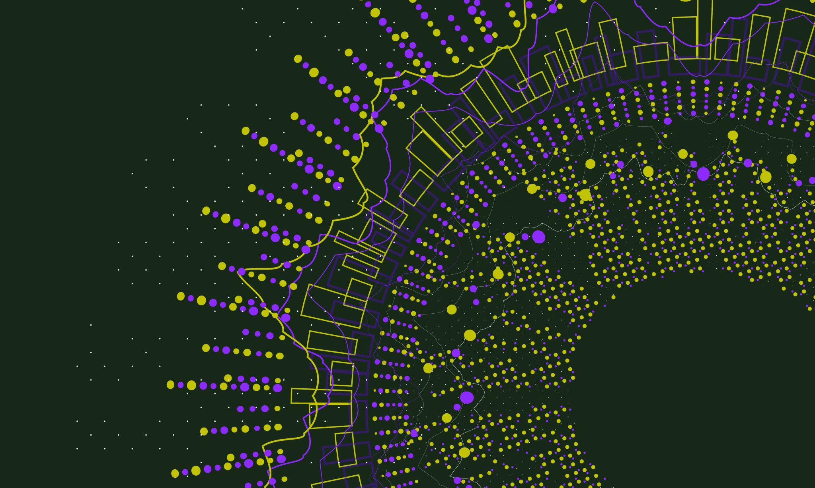
Natural Language Project using Google Cloud
Emre Beray Boztepe
350227

Slide 2
Basic Idea of the Project
Natural Language Processing becomes very popular for the last few years.
There are many NLP techniques (speech recognition, speech to text, text to speech, machine translation, sentiment analysis etc.) and softwares that uses NLP technique in the background (google translate, chat-gpt (using LLM))
I am planning to use one of the most popular data sets which is sentiment140.
Link: https://www.kaggle.com/datasets/kazanova/sentiment140

Slide 3
Tools and Services
Google Cloud Pub/Sub: Pub/Sub is used for streaming analytics and data integration pipelines to load and distribute data
Google Cloud Natural Language API: Provides a powerful set of tools for analyzing and parsing text through syntactic analysis.
BigQuery: A fully managed enterprise data warehouse that helps you manage and analyze your data with built-in features like machine learning, geospatial analysis, and business intelligence.
Google Data Studio: A web-based data visualization tool that helps users build customized dashboards and easy-to-understand reports. It helps in tracking key KPI's for customers, visualizing trends, and comparing performances over time.
Google Cloud Monitoring and Logging: Collect and view performance characteristics of your system, how you can monitor the availability of your services, and how you can be notified of problems with your services.
Data Ingestion - Google Cloud Pub/Sub
The pipeline to perform NLP on the data set - Google Cloud Natural Language API
Data Storage - BigQuery depending on the size of the data set
Visualizations - Google Data Studio
Monitoring and Logging - Google Cloud Monitoring and Logging
Programming Language - Python

Slide 4
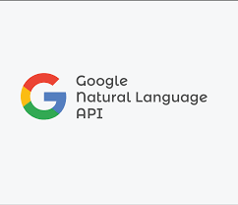
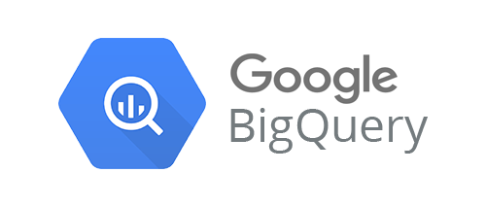
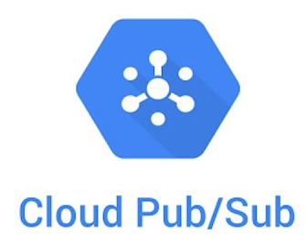
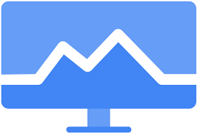
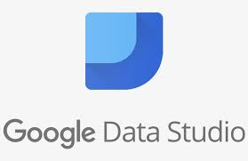
Project Flow

